Slide 1
AASD4011: Mathematical Concepts for Deep Learning
Course Outline

Slide 2
T431 and AASD4011
Period 1
Period 3
First Semester
MC ML1
Applied ML1
MC ML1
Applied DL1
Second Semester
MC DL1
Applied DL1
MC DL2
Applied DL2
Notes:
This is the “mathematical concepts for deep learning” course, which is part of the T431 program.
It is preceded by 4 machine learning courses.
This course is introducing deep learning to students who are already familiar with machine learning.

Slide 3
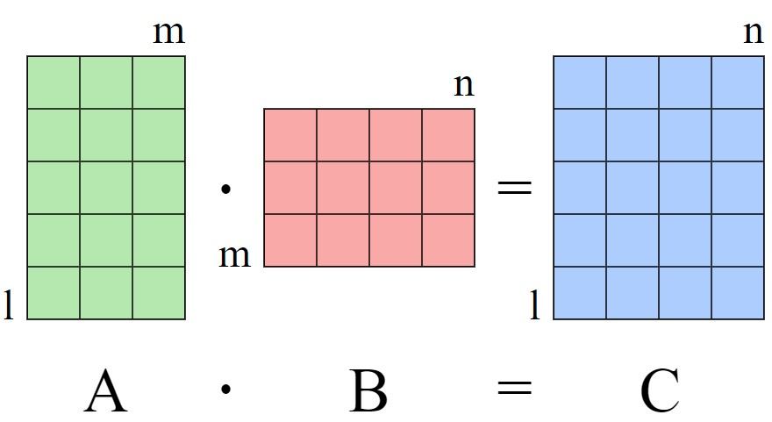
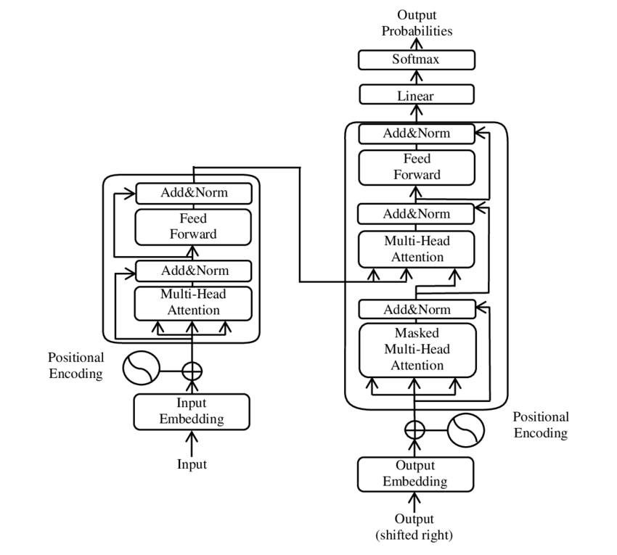
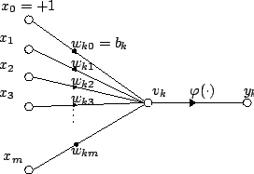
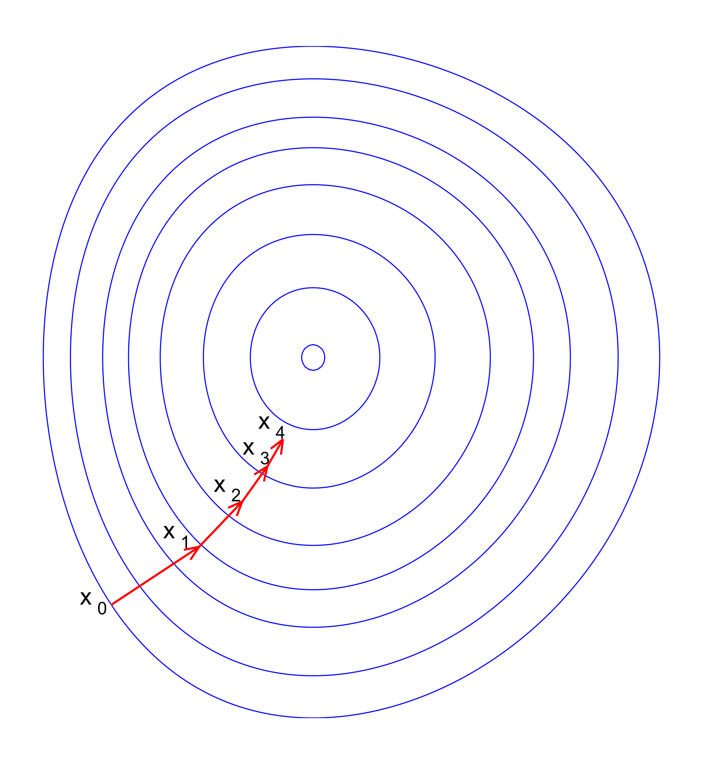
AASD4011: Two Parts
Fundamentals
Transformers
Wikipedia
Wikipedia
Wikipedia
By Yuening Jia, Wikipedia
Notes:
A main goal for this course is to allow the students to become proficient in the Deep Learning fundamentals. These fundamental concepts allow one to understand and explain how state-of-the-art, real-world deep learning solutions are implemented. We are going to start from the basics of deep learning, by introducing concepts such as tensors, optimization based on graduate grading decent, neural network architectures and activation functions. We will implement these basic concepts as part of the course, using PyTorch or Tensorflow. This part will go over about two weeks. These basic concepts are part of essentially every deep learning solutions regardless of the domain, whether it is visual, textual, auditory; or the type of task, be it analytical or generative.
The second part of the course will focus on deep learning for textual data, and will go over roughly two weeks. In that part of the course we will go over different types of recurrent neural networks introduce basic concepts for working with textual data using deep learning. Then we will introduce the Transformer architecture which revolutionized Text processing with deep learning. The transformer architecture is the one being used by essentially all state-of-the-art models in production and in academia for textual data (and in larger proportion for visual data). This technology is at the heart of models such as BERT and GPT.

Slide 4
Prerequisites
The course does not assume any prior knowledge of neural networks, deep learning, or natural language processing (NLP). However, it does assume that students have a working knowledge of Python and are comfortable in a development environment, as well as having a basic understanding of Git and experience using an IDE such as VSCode.
In terms of hardware requirements, most classes will not require a GPU. Having your own GPU-equipped machine (either locally or in the cloud) can help you build valuable skills for the long term by giving you experience setting up a DL development environment but is not required. As an alternative, it is possible to use a browser-based notebook service like Google Colab or Kaggle's if GPU resources are required.

Slide 5
Detailed Outline
CSI
In Blackboard

Slide 6
Learning Goals
Following graduation, the student is expected to be able to:
Explain the fundamental ideas and methods behind Deep Learning, including Transformers, with an emphasis on application in the text domain.
Train simple feedforward and recurrent neural networks
Fine-tune a Transformer
Use PyTorch and Tensorflow for training neural networks

